Slide 1
Quality Control “Web Services”
A brief How to Operate Summary

Slide 2
System Access
Click this Link:

Slide 3
Available Tools
IDAR
LOT Trace
PCS (Product Contact Sanitization)

Slide 4
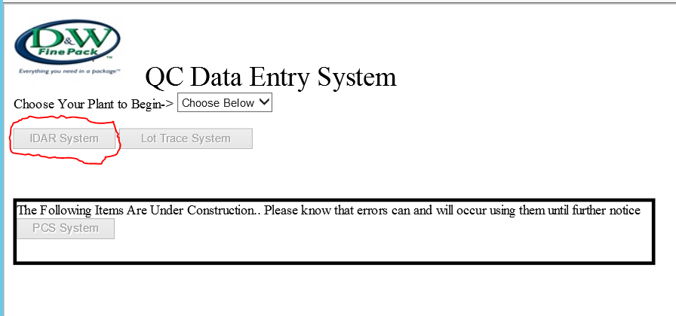
IDAR
To Begin Select the Plant
Note: All Steps in this IDAR process are Emailed to the End Users and managers

Slide 5
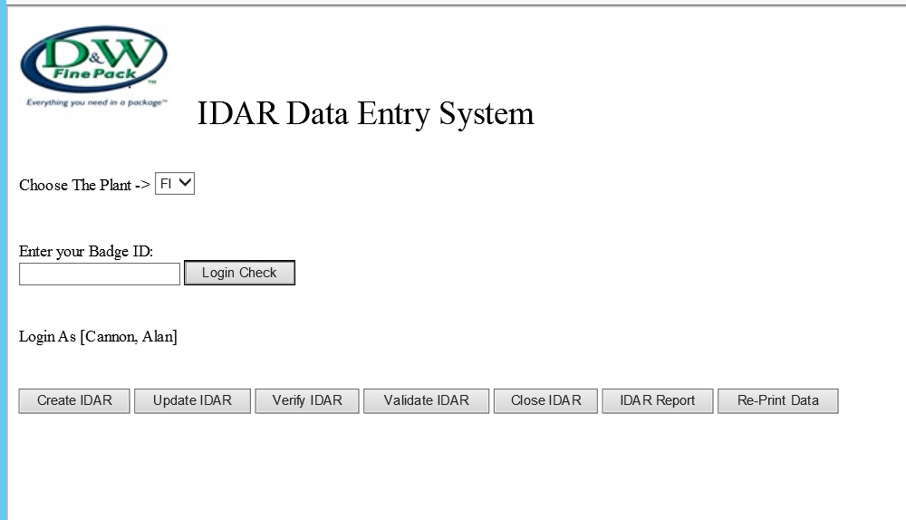
IDAR
You are obliged to Enter your Badge ID from you badge and Push the Login Check button
If you entered a Valid Id the System will display your Name and Grant access to the Available functions.

Slide 6
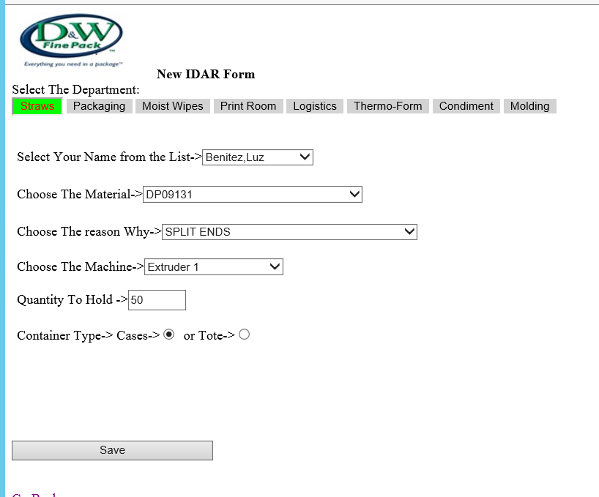
IDAR Create
Select your department of interest. Based on your Previous entries the User name will be selected else a list of available users will be displayed.
Next fill out or select the from the available items on the screen

Slide 7
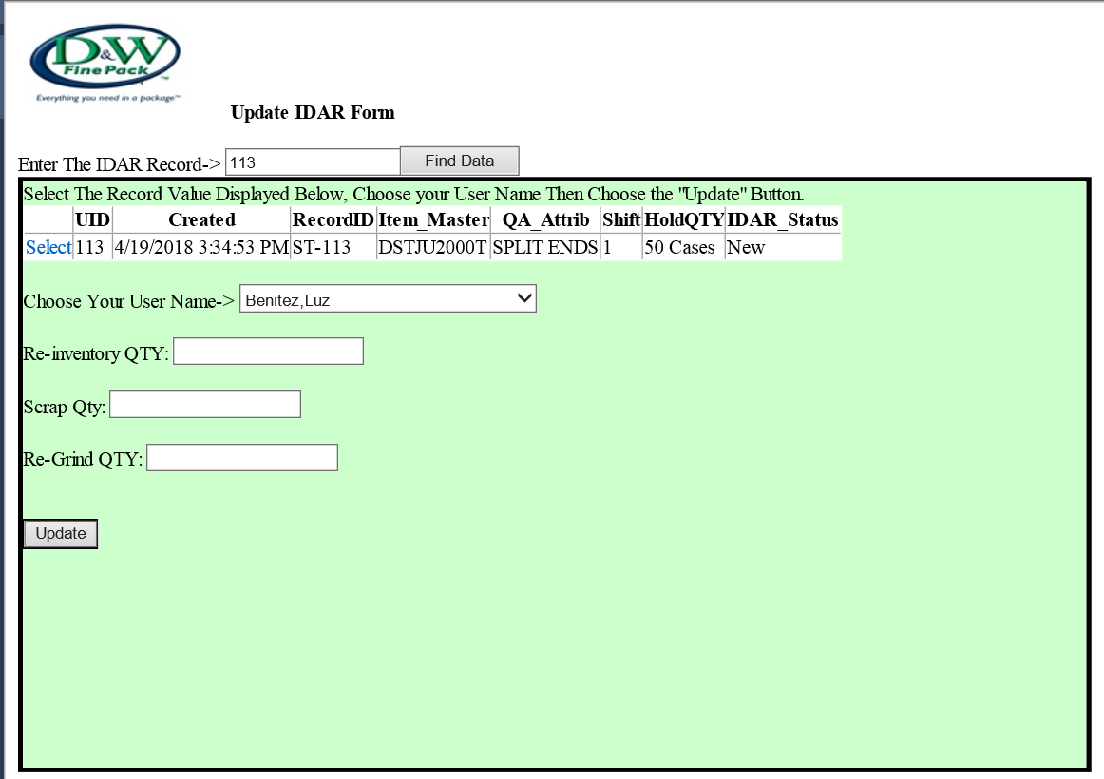
IDAR Update
Enter the Record locator for the email into the Provided Box:
The data will be displayed for you to provide the appropriate responses needed.
After you update the Data will refresh with the Status of “Updated”

Slide 8
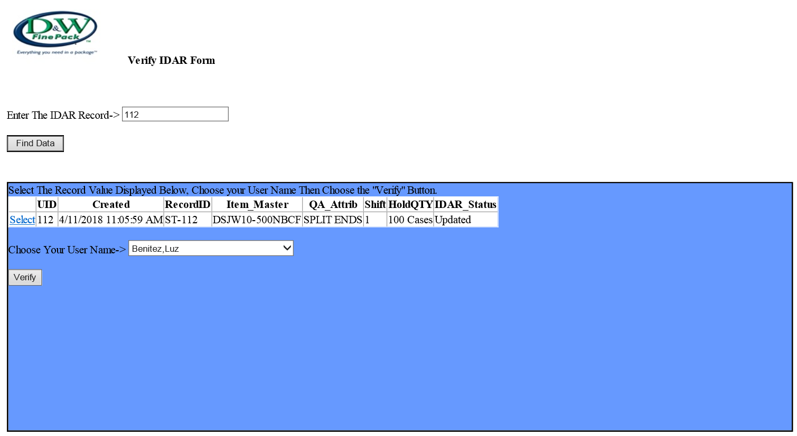
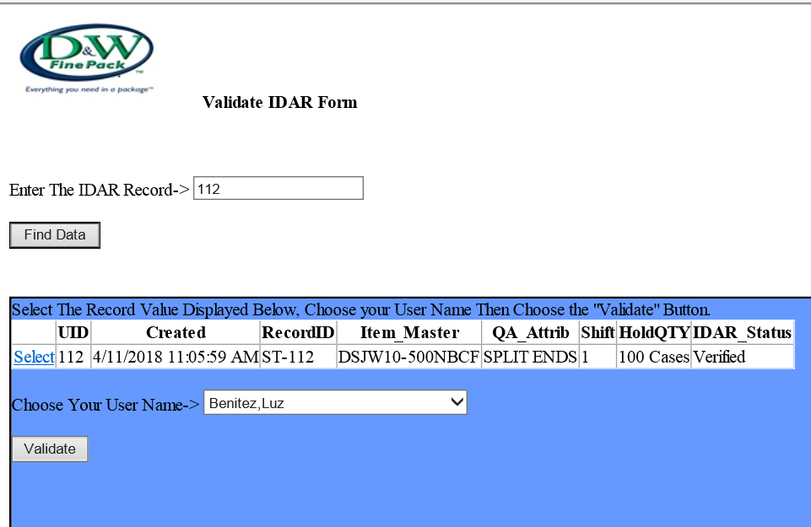
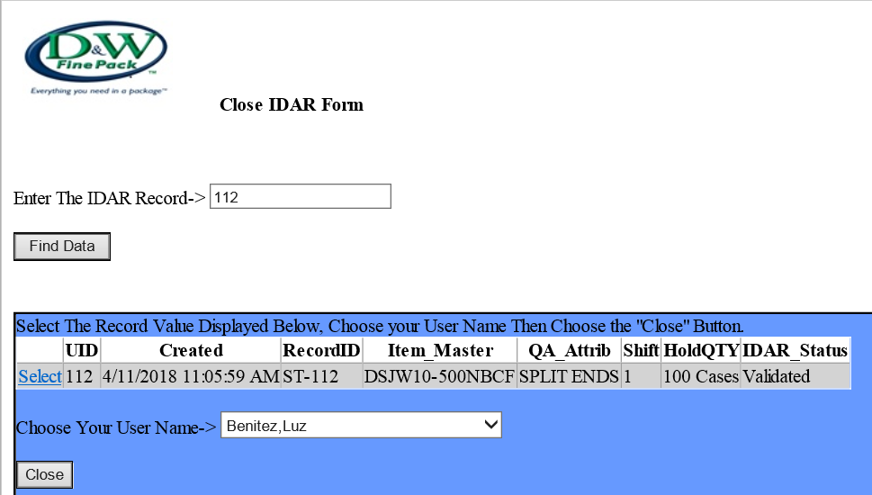
IDAR Verify, Validate and Close
Enter the Record locator for the email into the Provided Box:
The data will be displayed for you to provide the appropriate responses needed.
After you update the Data will refresh with the Status .

Slide 9
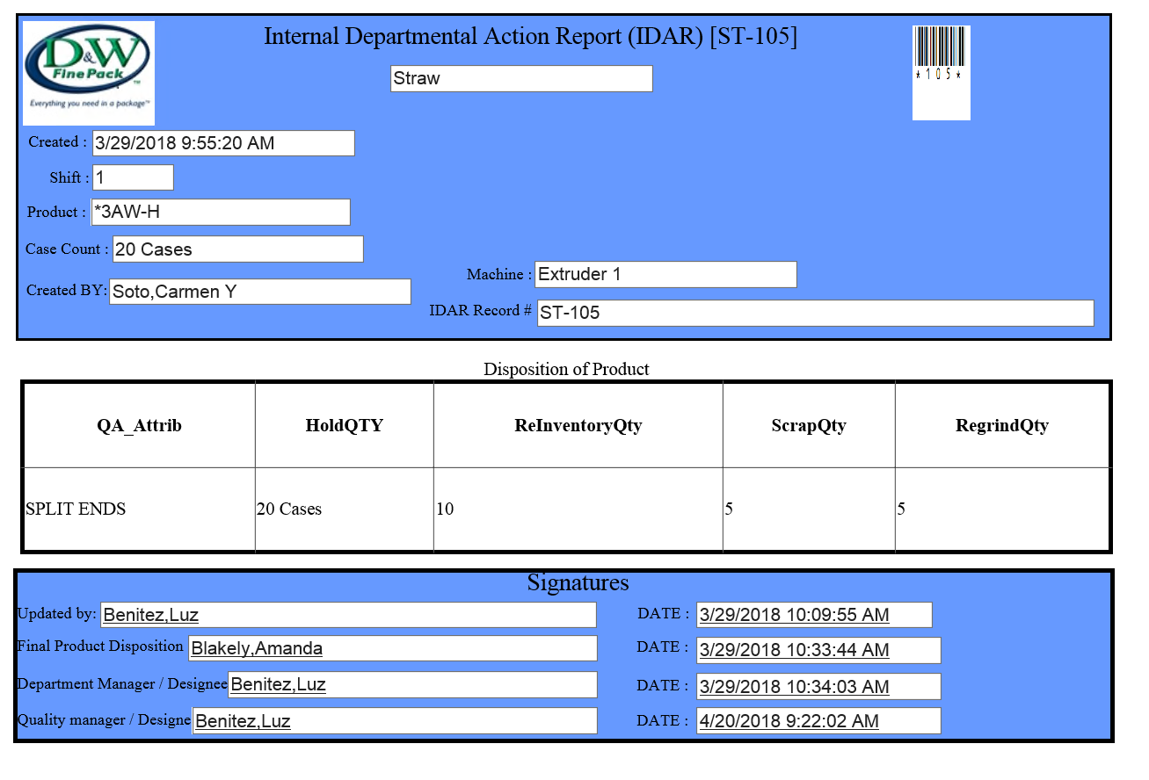
IDAR Print
For Record Keeping if necessary the system after a Valid Close event will open this screen and you can Screen Print

Slide 10
Available Tools
IDAR
LOT Trace
PCS (Product Contact Sanitization)

Slide 11
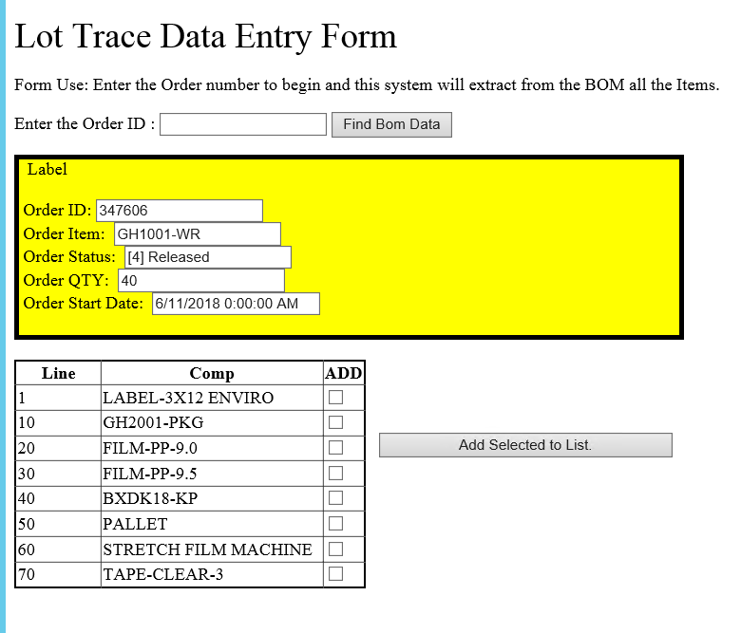
Lot Trace
Begin with an Order Number from The Baan System and enter it into the Order ID Field
The System will return the Necessary Data from Baan and Display as Shown.

Slide 12
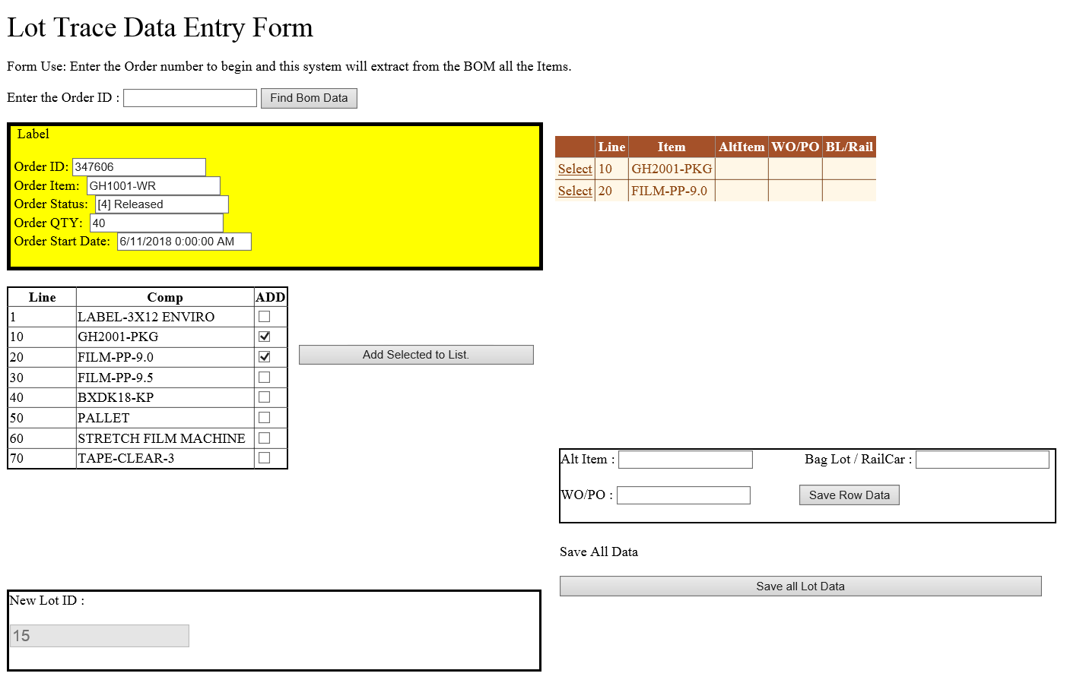
Lot Trace
From the Item Master data Select “Add Check Box” for the items that need Lot related information, then Select Add Selected to List.
Once your items have been added a Second Box will be Shown with your data.
Select / Click the Line Items “Select ” text
Enter into the Fields the Line item specific supplier Lot code information and choose Save Row Data for each Selected Item
After you have added all the necessary data Choose the Save all lot data to create a New Lot ID and Store your Supplier specific Lot data
When all tasks have been completed a New Lot Number Box will be shown. This is the Actual Lot number to be used by Manufacturing

Slide 13
Available Tools
IDAR
LOT Trace
PCS (Product Contact Sanitization)

Slide 14
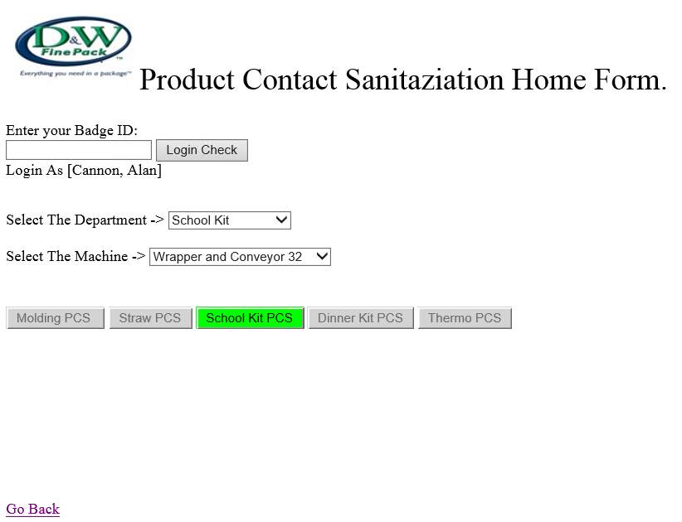
PCS
Begin by entering your Badge ID, Select the Department and Choose the Machine in that department.
Once Valid one of the Department PCS buttons will be Shown to allow the Next step

Slide 15
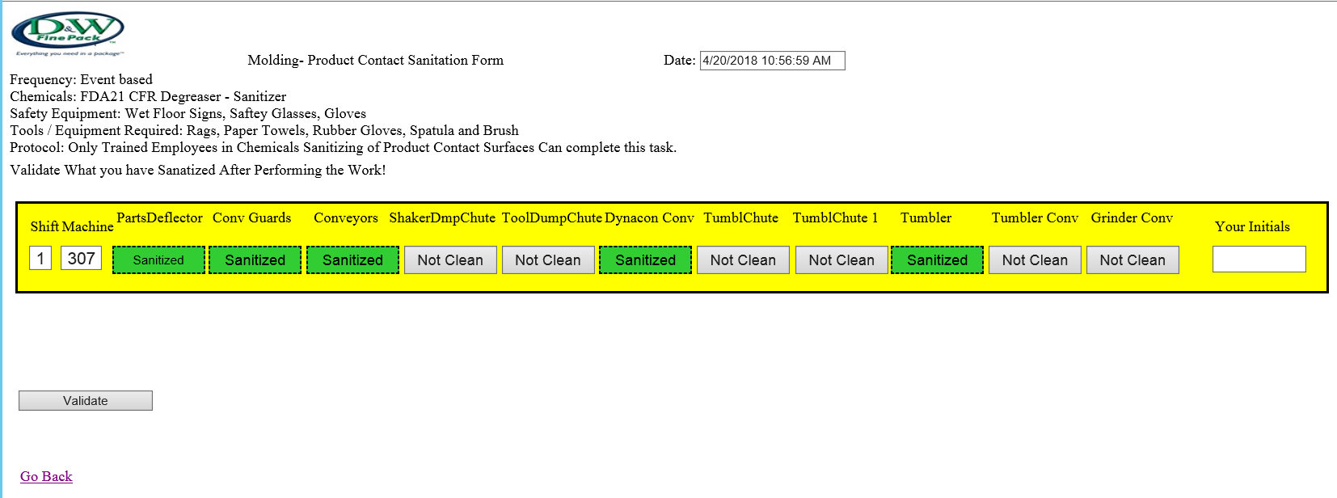
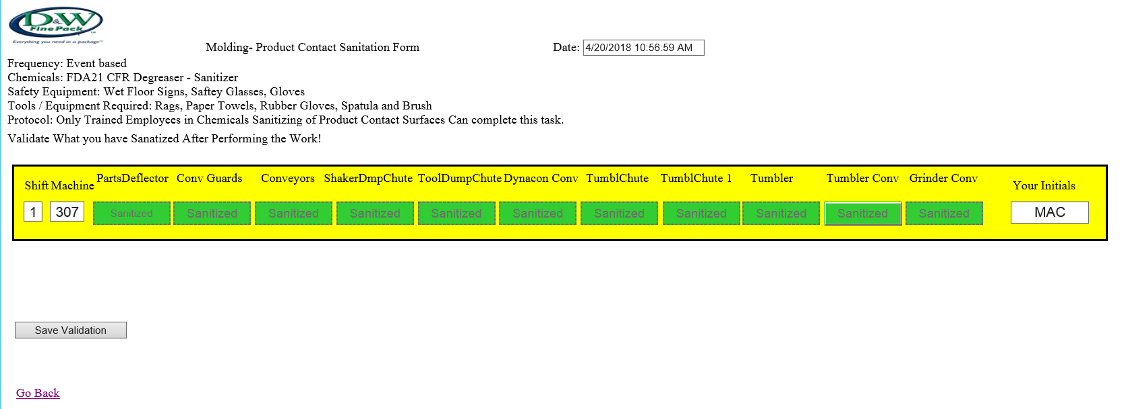
PCS
Select the Buttons on the Screen to Set the Items as Sanitized. Based on the Minimum required objects a Validation check is required

Slide 16
Quick Reference Info.
As with all applications in Fountain inn Systems they can be accessed using a Standard Web Browser for the Machine HMI or The machine Data Reporting services. To access the objects please visit these sites:
History = http://devautosql01:7300/DWFP_MES_Home.aspx
Reporting = http://devautosql01/ReportServer
There are multiple folders within this system and are accessible with your DWFP\username account. If you receive and error on Logon() please contact the Fountain inn Automation team for access.
Contained within these report tools are Downtime, Production Counts and OEE

